Slide 1







2017
2017
Build an immutable application infrastructure with Nano Server, PowerShell DSC, and the
release pipeline
DSC in a vSphere Environment
Ravikanth Chaganti
LucD

Slide 2
Agenda
A bit of history
Concept
Choices
Bumps on the Road
Birdseye
Close Up
Reverse

Slide 3
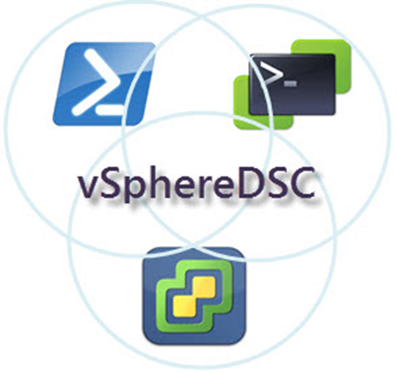
History
SDDC: one way is DSC
PowerCLI is my tool of choice
PowerShell
VMworld 2015
First public repo GitHub
PowerShell v5 (Feb 2016)
Hackathons VMworld 2016
PowerCLI v6.5R1 (Nov 2016)
PowerShell v5.1 ()

Slide 4
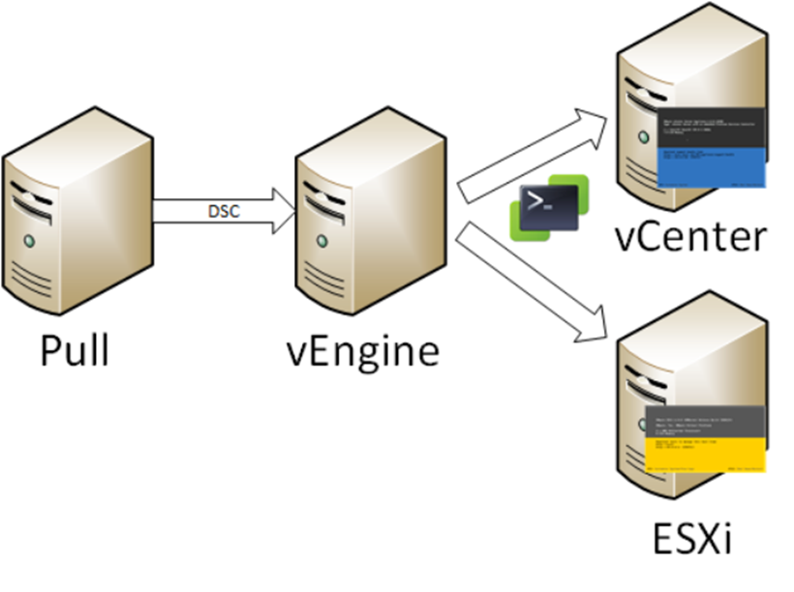
Concept
vSphere Servers: closed box
vCenter (VCSA)
ESXi node
vEngine
LCM
PowerCLI
Connects

Slide 5
Choices
vEngine currently a Windows (W2K16) box
Secure environment (AllSigned)
Classes
Inheritance
MOF
All vSphere code uses API directly
Faster
Covers features not available in PowerCLI cmdlets (80%-20% rule)

Slide 6

Pitfalls 1
Pre PowerCLI 6.5R1
PSSnapins
No autoload available
Security
Certificates
Code signing
Credential encryption
Using module & RequiredAssemblies
LCM fails at MOF generation
PowerCLI code in “helper” file (again!)

Slide 7
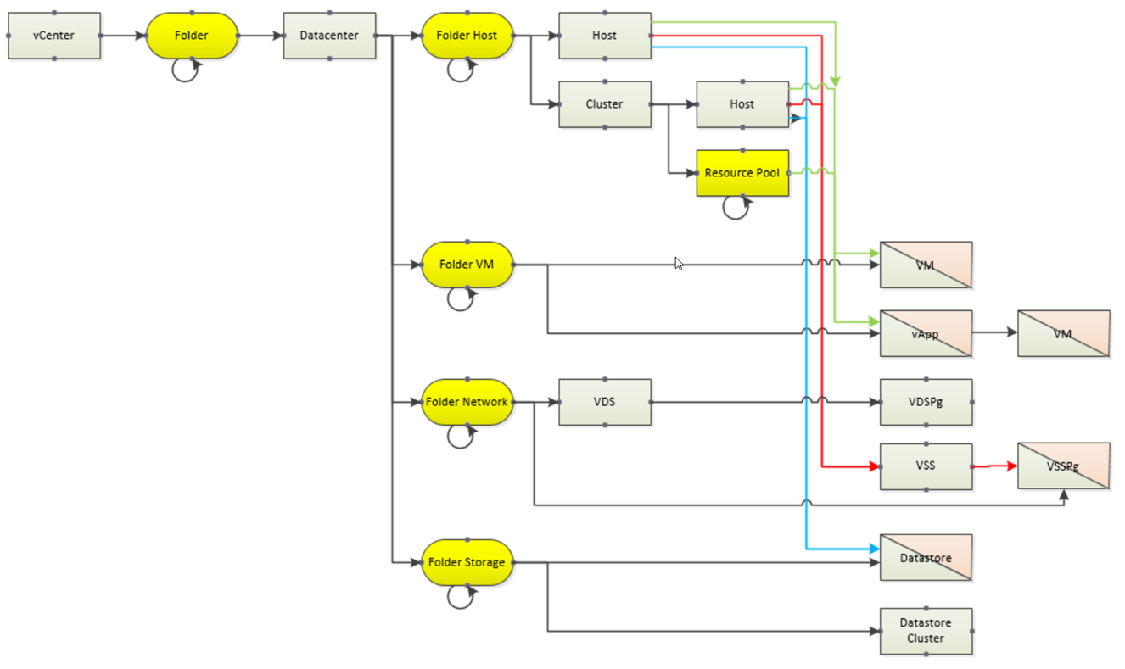
Pitfalls 2
(vSphere -contains legacy) –and (vSphere.design –isnot [logical])

Slide 8
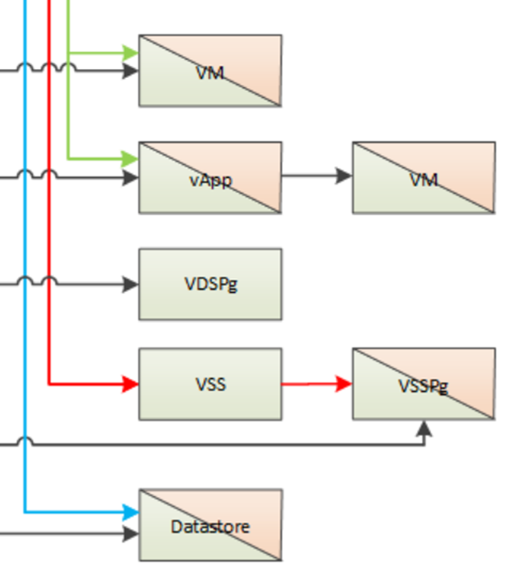
Pitfalls 3a
How to uniquely address a vSphere object
Common = VmwBase class
Name (e.g. Folder1)
Path (e.g. /DC1/Folder1)
Several objects have more than 1 path

Slide 9
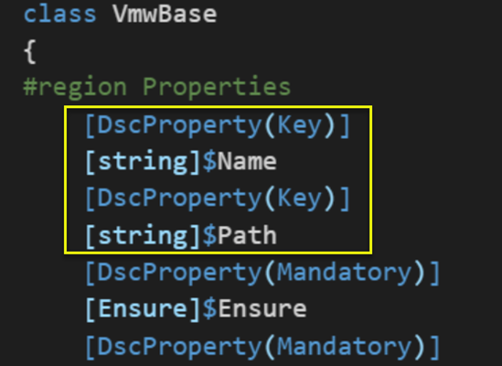
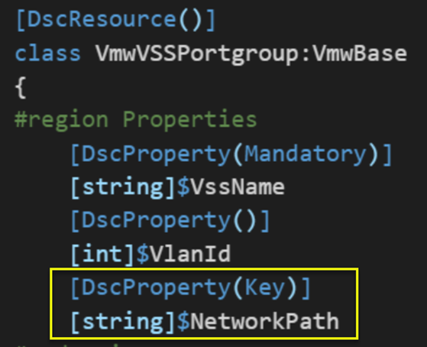
Pitfalls 3b

Slide 10
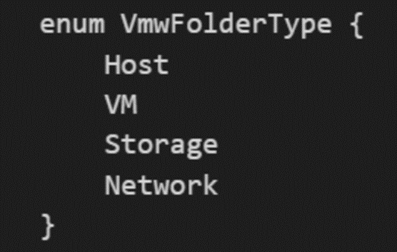
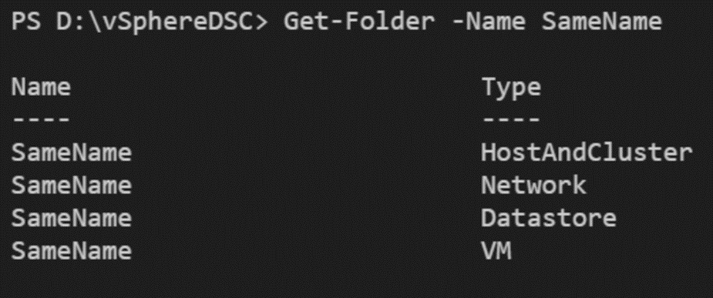
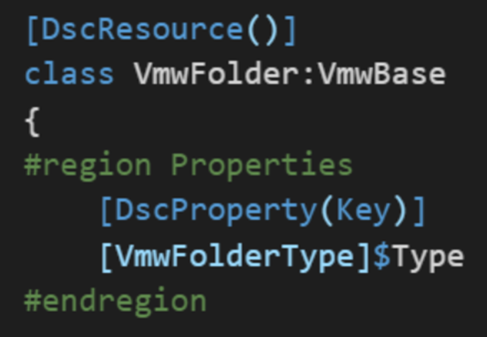
Pitfalls 4
Folder with identical Name
FolderType

Slide 11
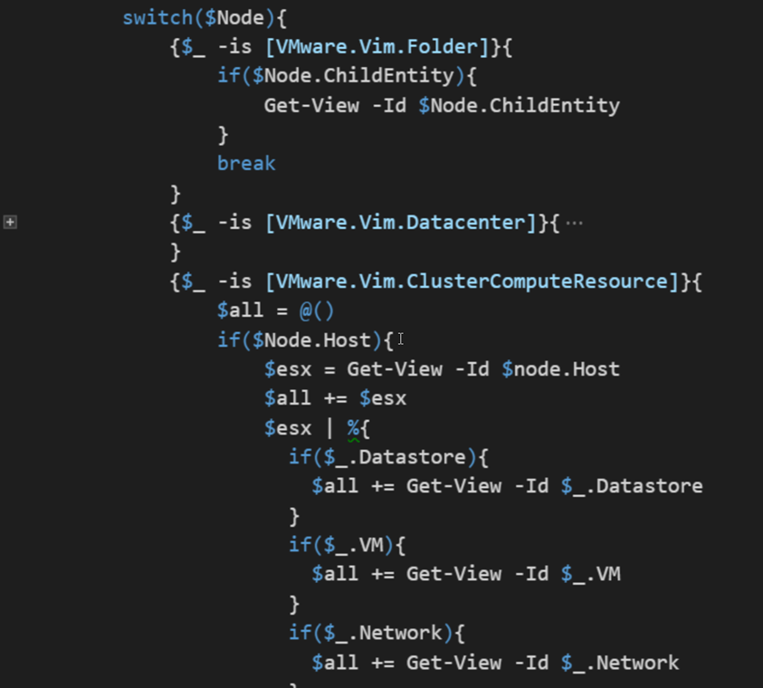
Pitfall 5
Traversing the vSphere tree
Legacy structure
“Parent” property absent for some

Slide 12
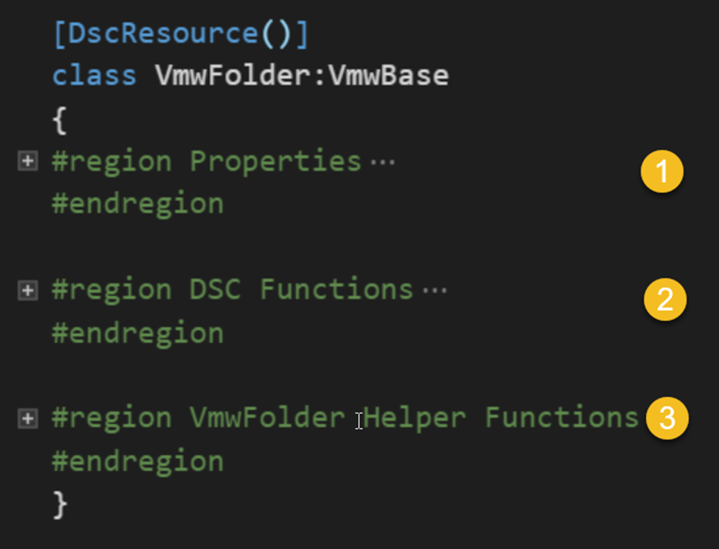
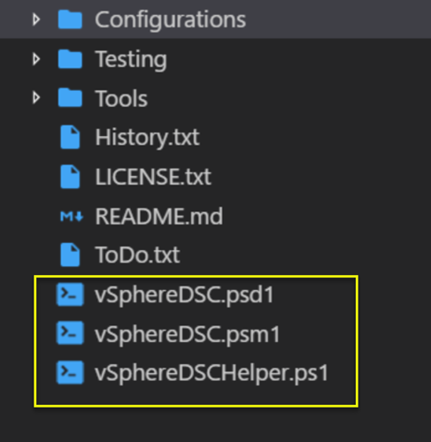
Birdseye 1
Simple, “clean” structure
Each resource, same layout

Slide 13
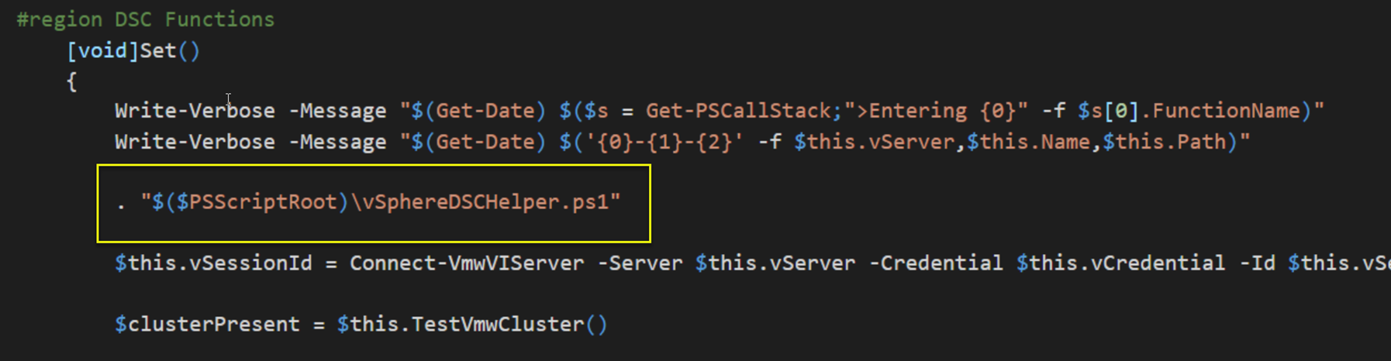
Birdseye 2
Separate PS and PowerCLI code (Vmware.Vim types!)
All PowerCLI code in vSphereDSCHelper.ps1
Dot-source
Not elegant, but it works!

Slide 14
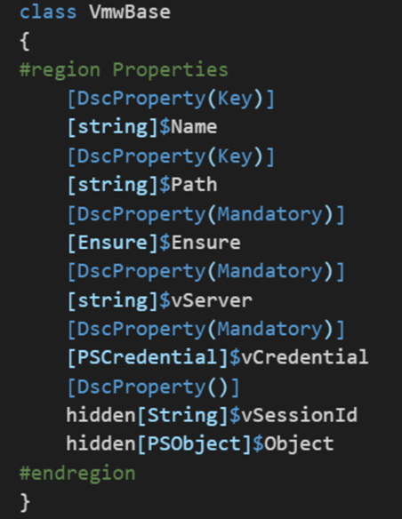
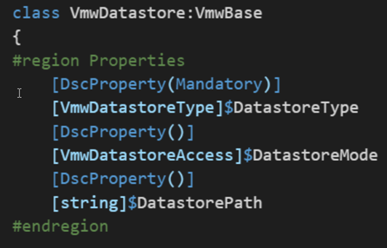
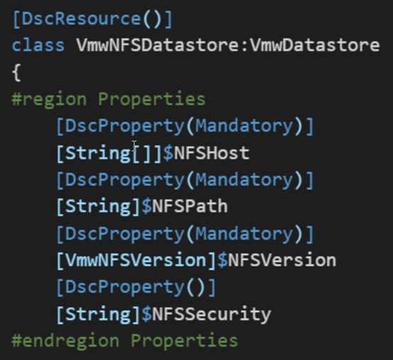
Details 1
Properties
Classes + inheritance

Slide 15
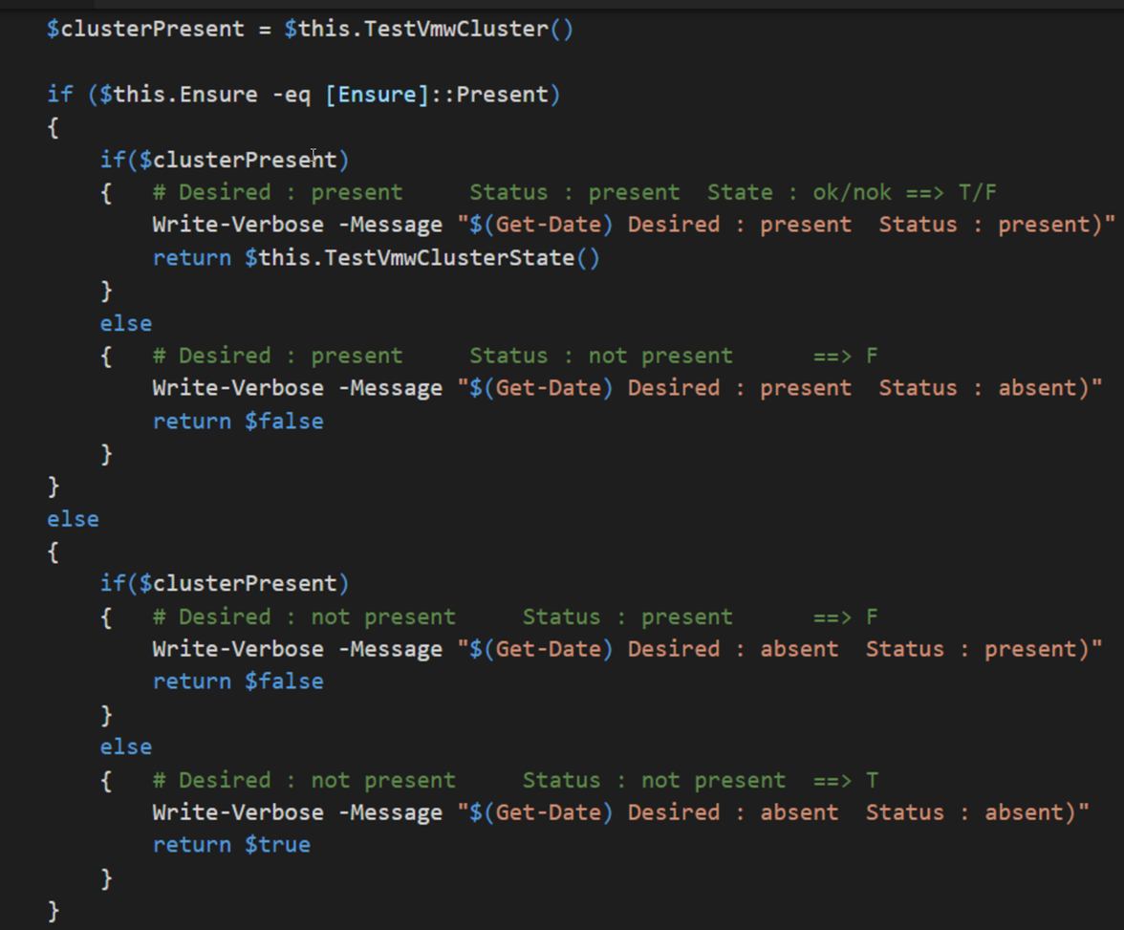
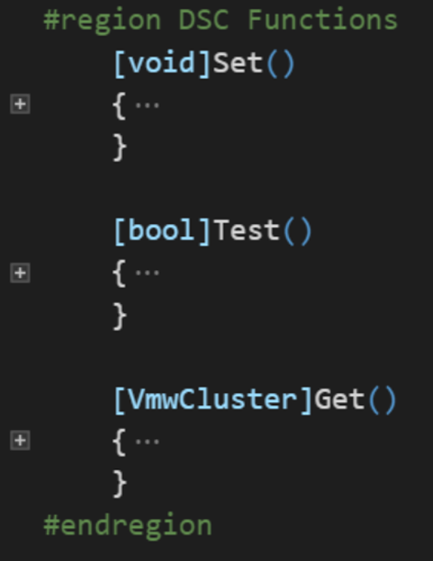
Details 2
Test/Set/Get: only the logic
No PowerCLI!
State of an Object!

Slide 16
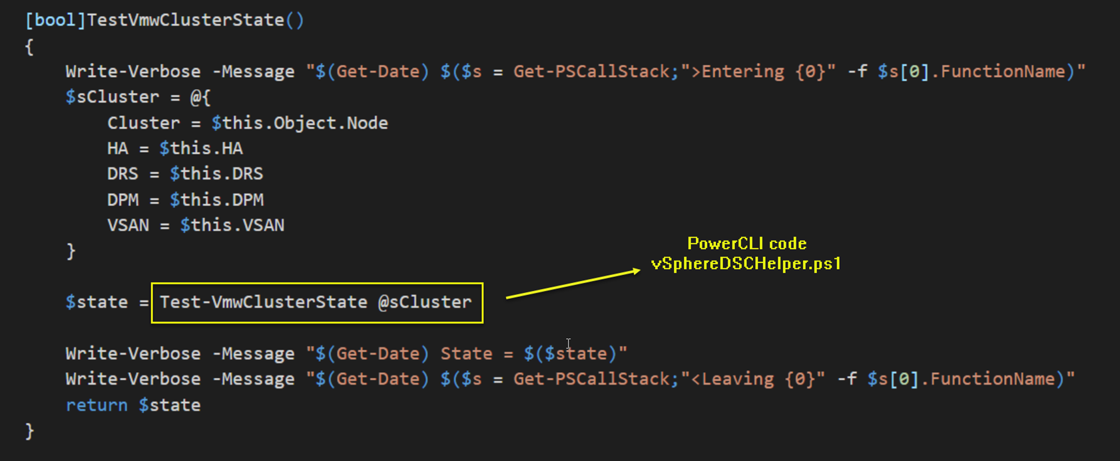
Details 3
Logic beyond DSC functionality. Helper functions
“Knows” about vSphere

Slide 17
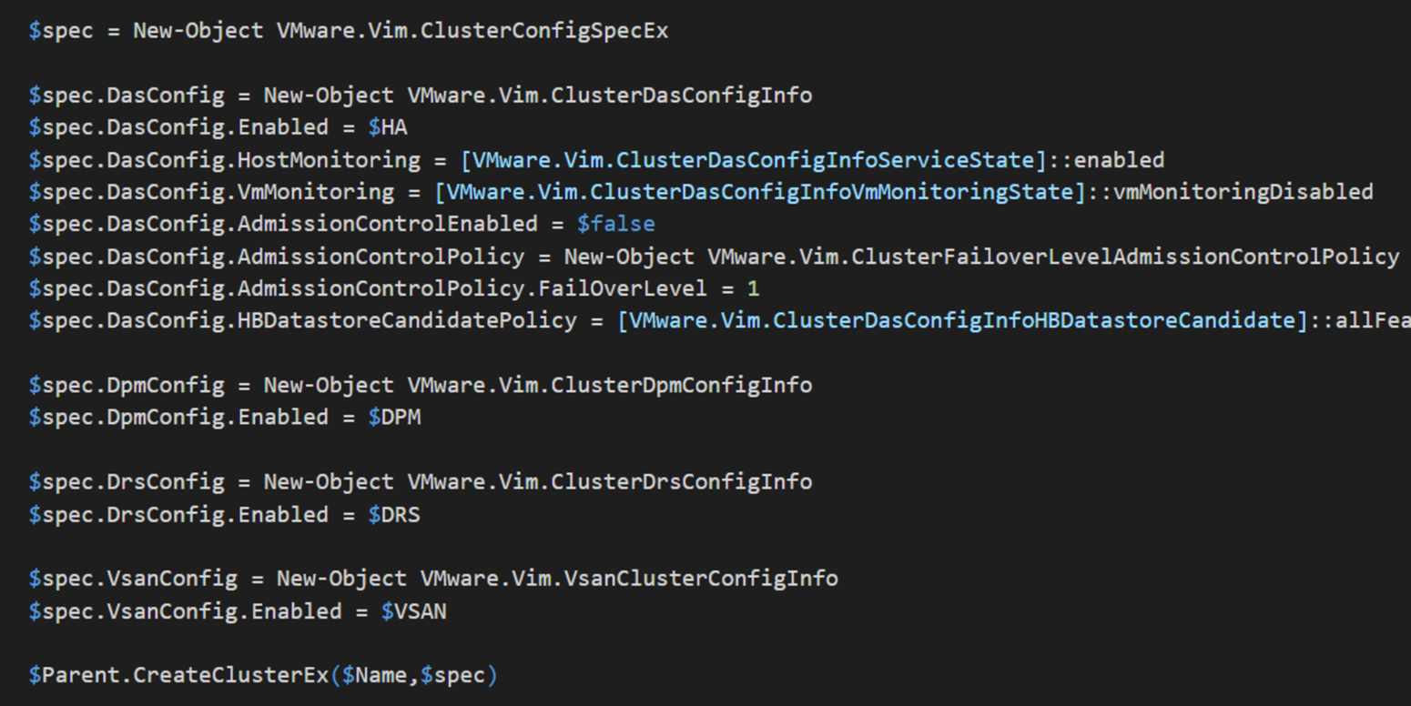
Details 4
PowerCLI code in vSphereDSCHelper.ps1

Slide 18
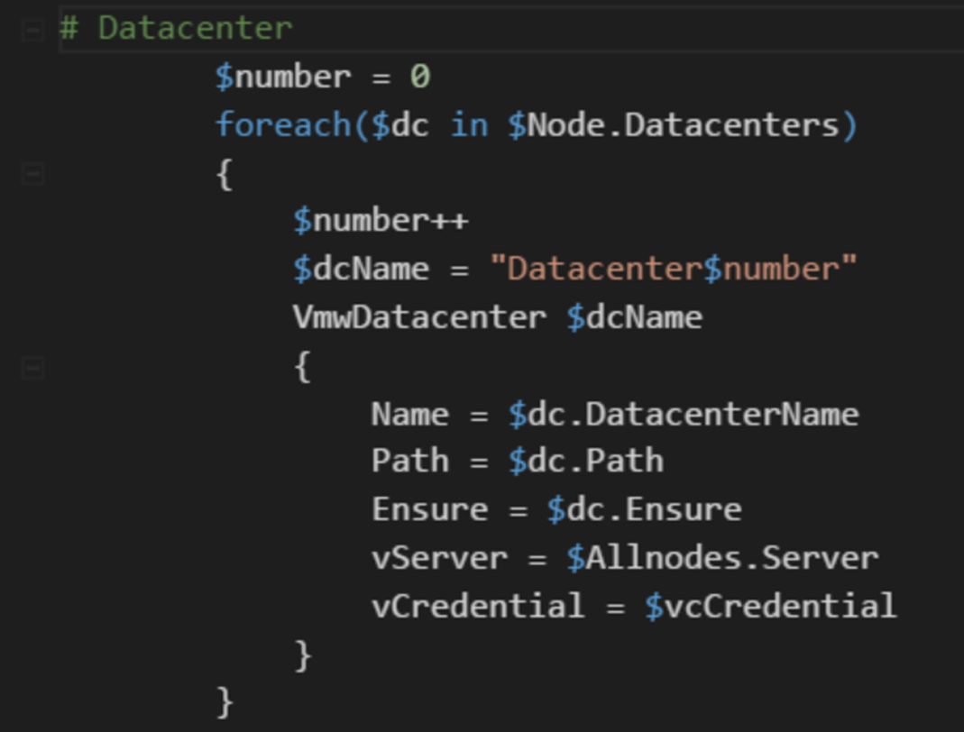
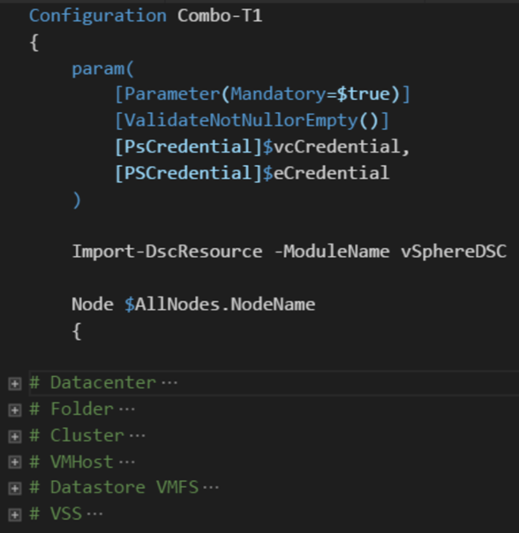
Details 5
Configuration file
Separate What from Where
Fixed Structural lines

Slide 19
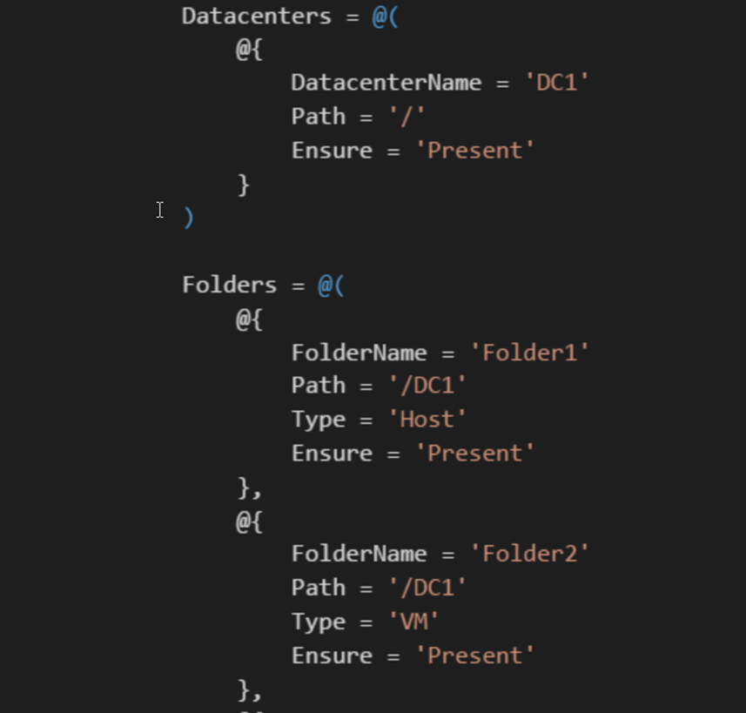
Details 6
ConfigurationData in .psd1 file
No variables
Use Configuration parameters
No Enum
Use String
Source control!
Txt file ➔ diff

Slide 20
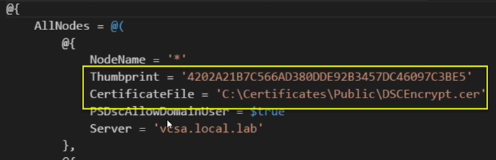
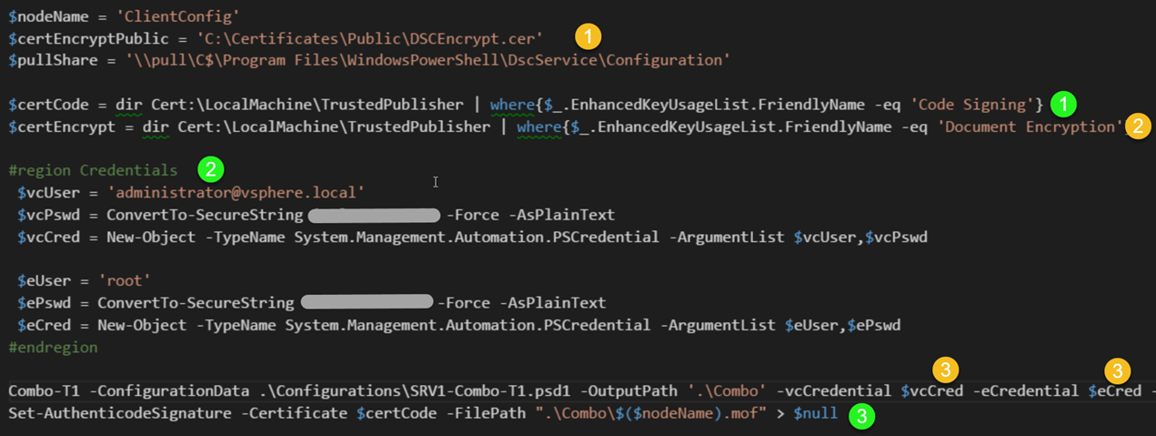
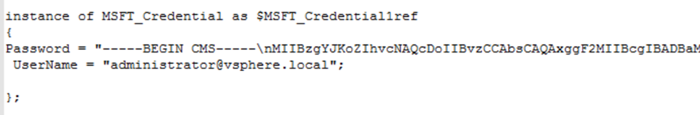
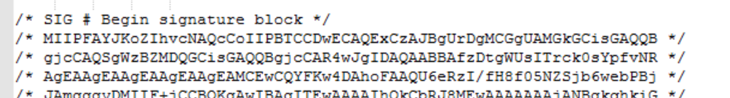
Detail 7
Security
Configuration signed
Credentials encrypted

Slide 21
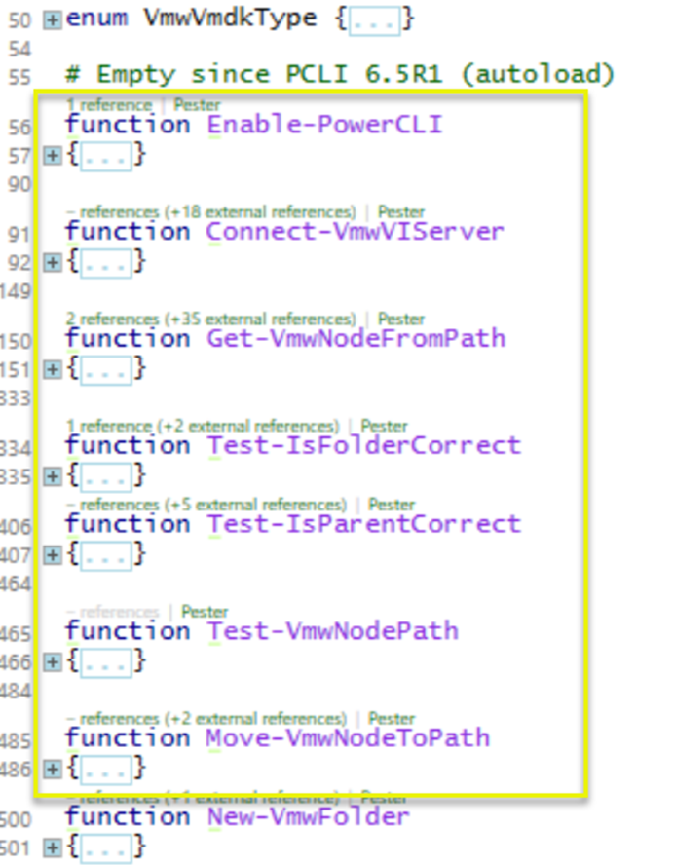
Detail 8
Basic Helper functions
In vSphereDSCHelper.ps1
Functionality
vSphere server connect
Locate node (test for node + locate parent for new node)
Test if folder is correct
Test if parent is correct
Move a node to a location

Slide 22
Combined resources
Populate VCSA

Slide 23
Future Developments
Add more resources
Improve testing (Pester)
Unit: quite simple
Integration: requires Greenfield/sandbox
Better ideas welcome
Provide (easy) test environment setup
I used Vagrant
DSC based?
Add Tooling (remember DSC is a framework)
Environment ➔ Configuration files

Slide 24
Join in!
BitBucket ➔ Github
Creating a new resource is simple
Blogpost cookbook style following
Logic is copy/paste + minor edit
Helper functions require PowerCLI
Prototyping with PowerCLI cmdlets

Slide 25
Template structure
vSphereDSC.psm1
Copy an existing resource
Define class properties (Key & Mandatory!)
Review Get-Set-Test ➔ minimal change
vSphereDSCHelper.ps1
Same set of functions
New/Remove
Test/TestState/SetState
Proto-typing: PowerCLI cmdlets
Production: API methods

Slide 26
Reverse
vSphereDSC Resource module allows vSphere configuration through Configuration files
How can we get Configuration files for an existing vSphere environment?
Painstakingly write it out
Automate that process
Why would we need such Configuration files?
SDDC
Diffs
Audit
….

Slide 27
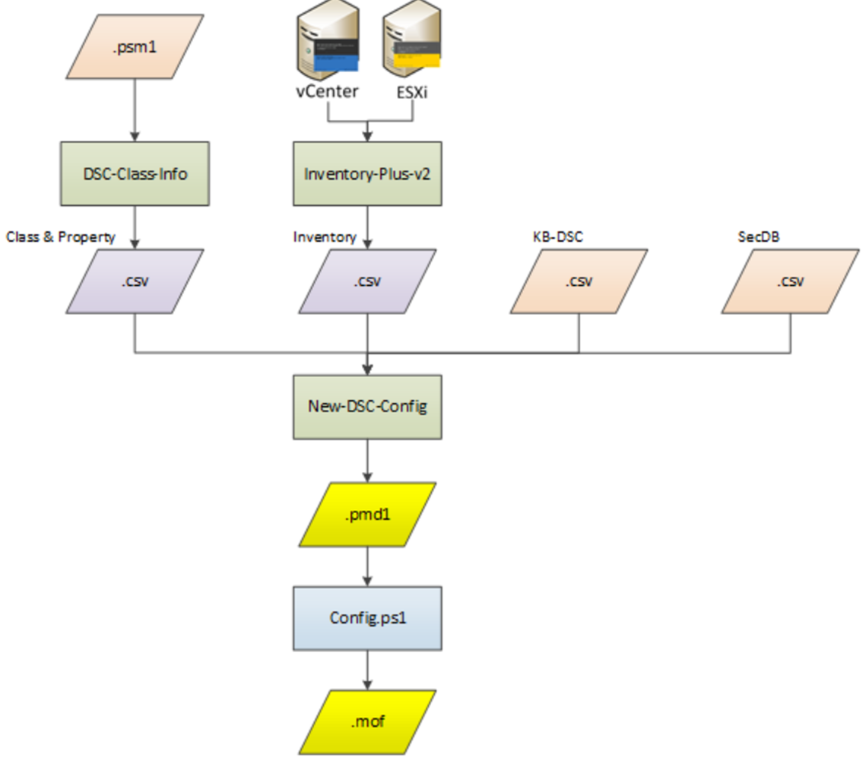

Slide 28
Get-DSCClassInfo
DSC-Class.Info.ps1
Extracting Class information
Input .psm1 file
Use Abstract Syntax Tree (AST)

Slide 29
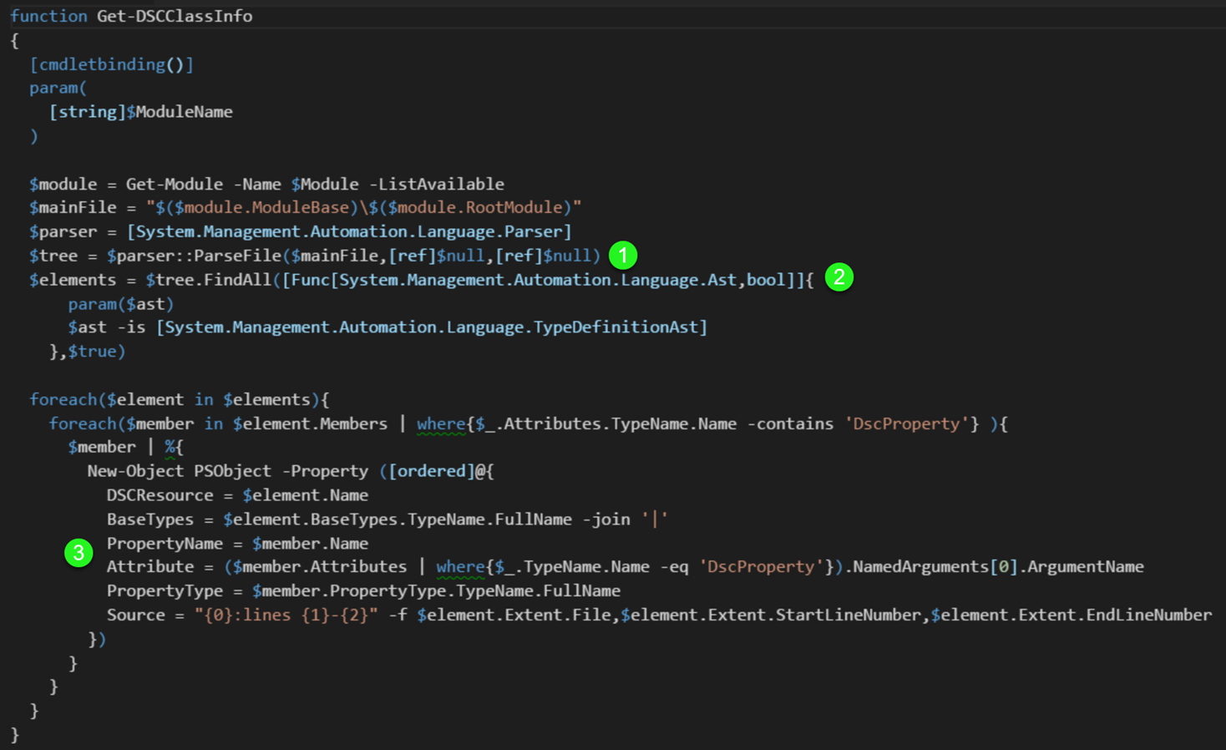

Slide 30
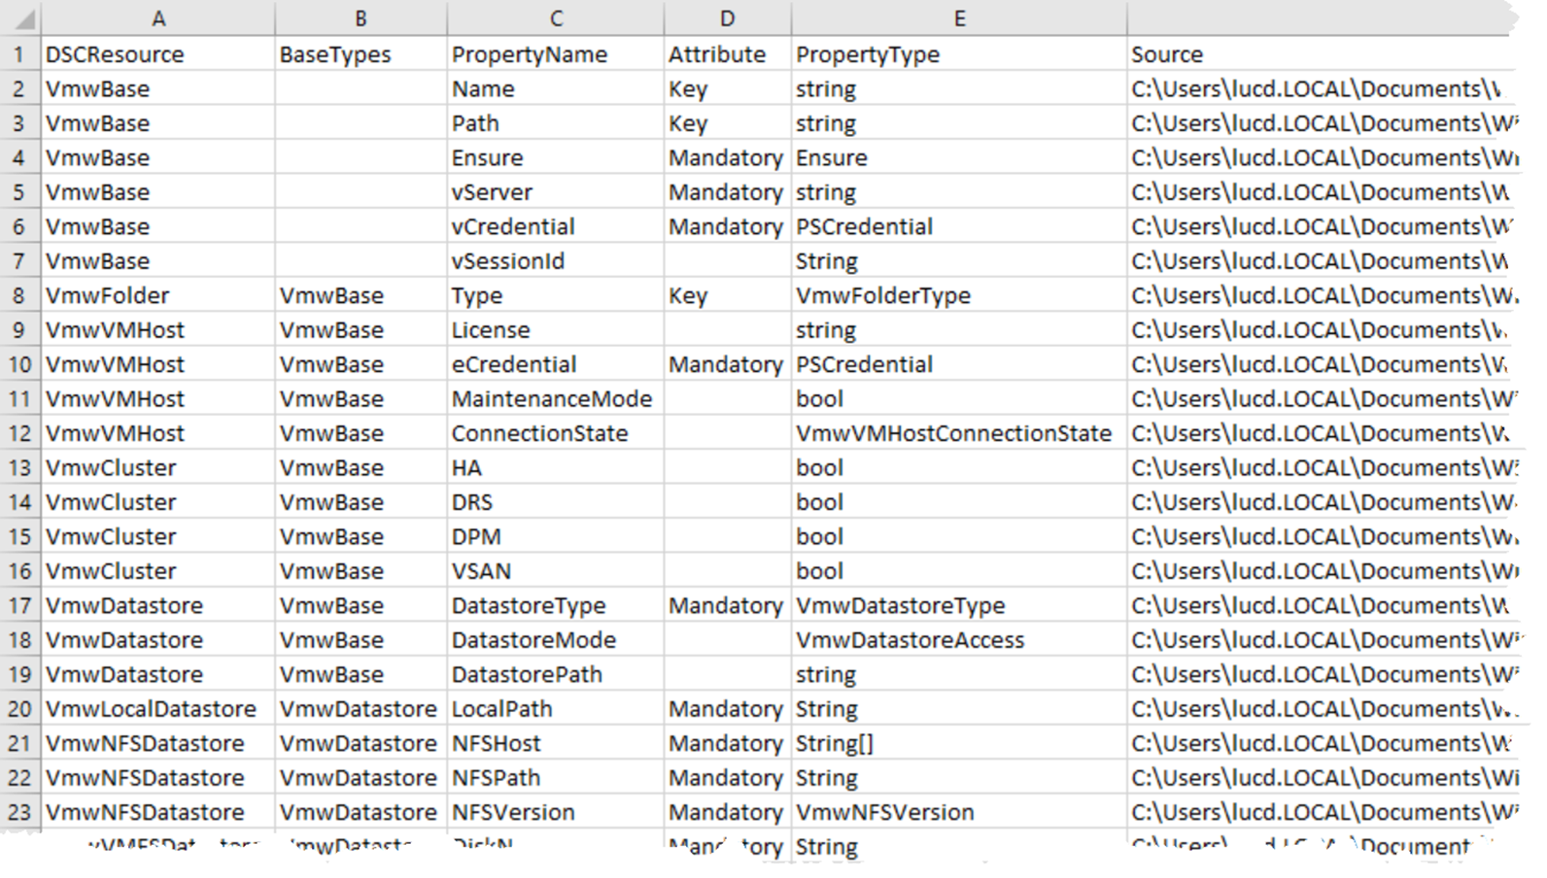

Slide 31
Get-InventoryPlus 1
The Get-Inventory cmdlet does not return all object we want
There is a requirement to see “all” paths for objects

Slide 32
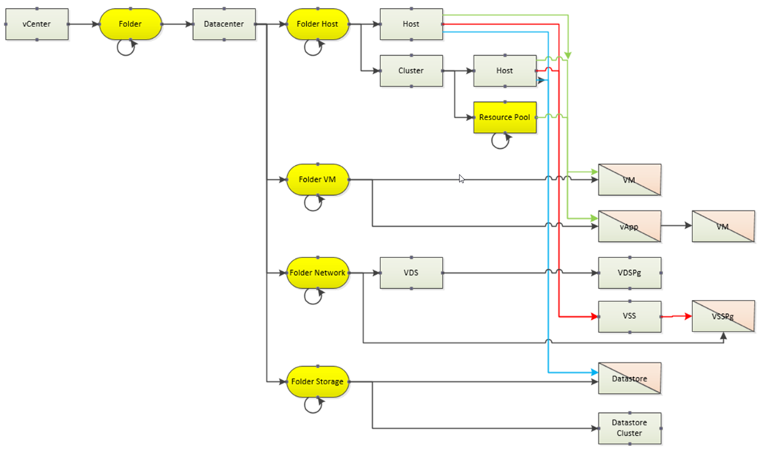

Slide 33
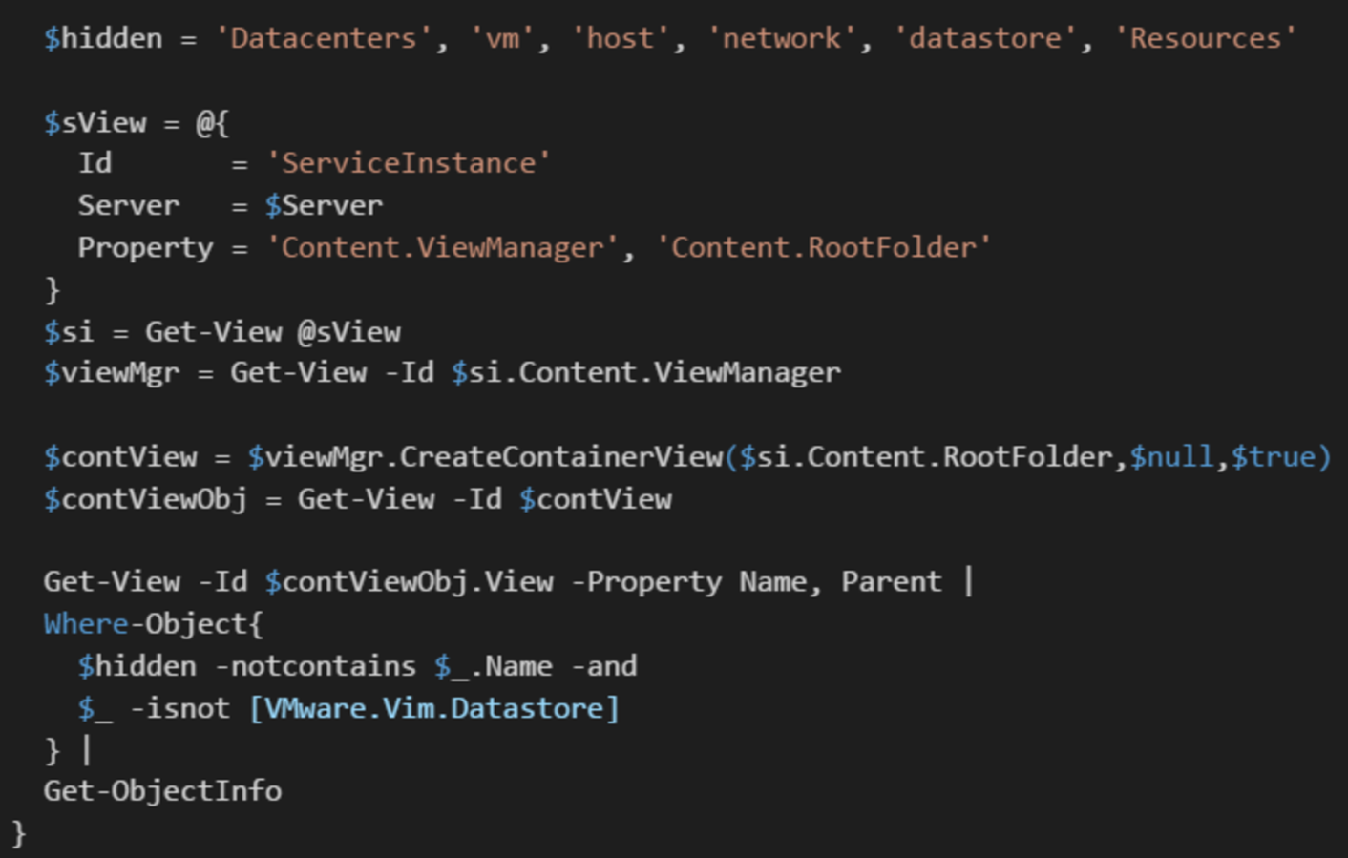

Slide 34
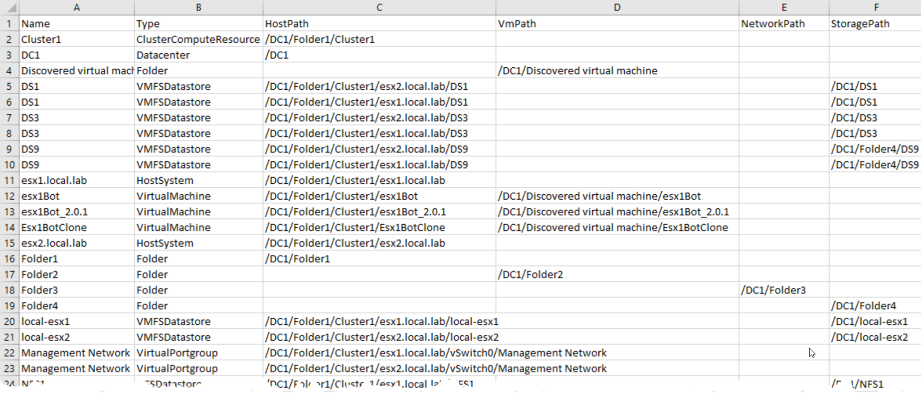

Slide 35
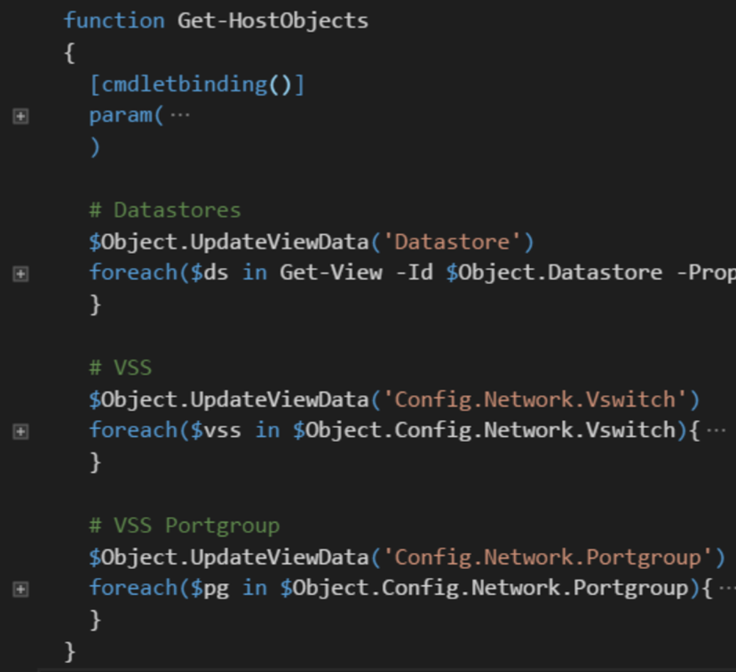
Get-InventoryPlus 2
Some objects only visible through ESXi node!

Slide 36
KB-DSC 1
Configuration data needs the values for the “where” data
This DB contains the formula on how get the value for a class/property

Slide 37
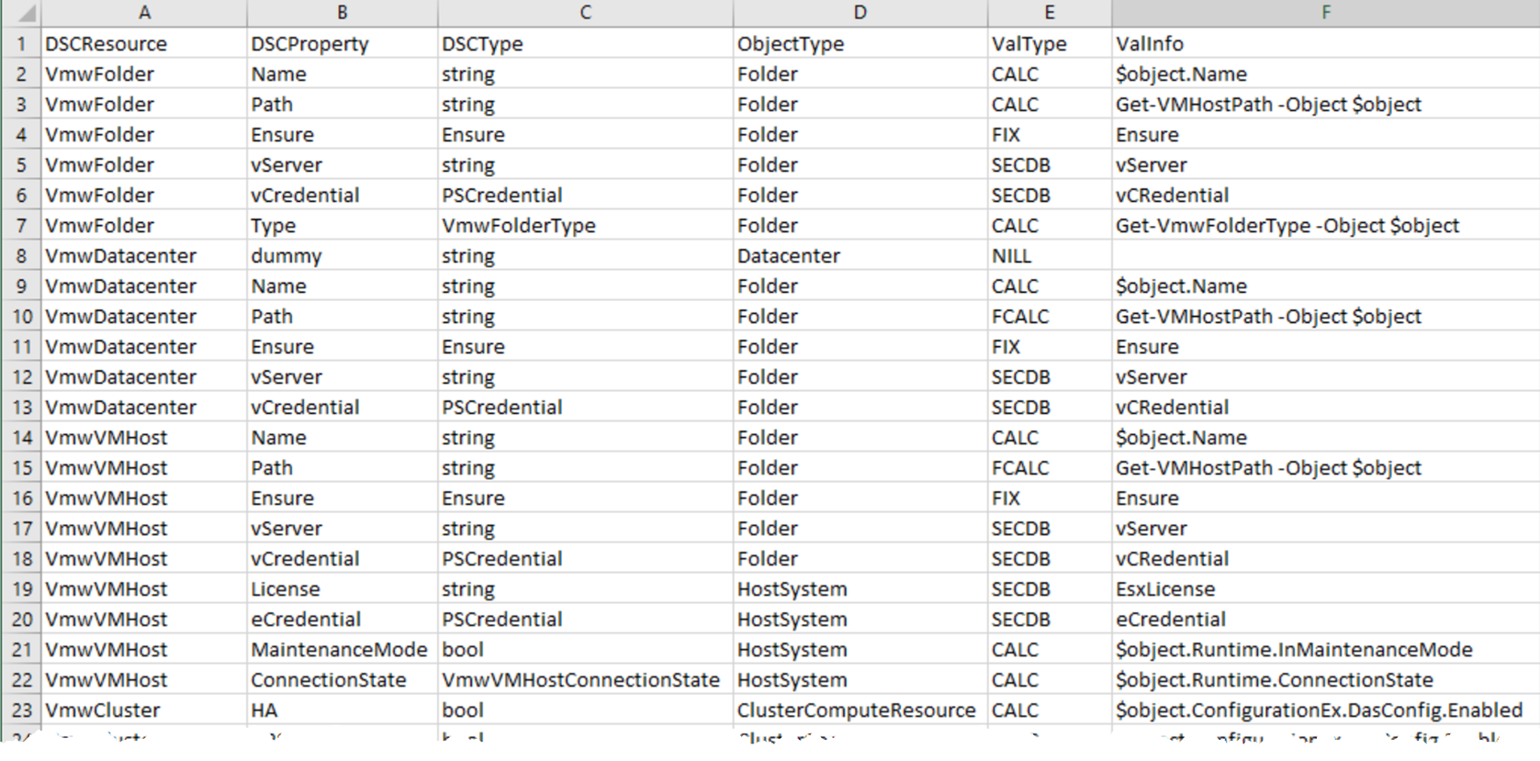

Slide 38
KB-DSC 2
The ValType and ValInfo fields indicate how a value can be retrieved
Currently there are following options
FIX: a constant value
CALC: property, the current object is in $object
FCALC: function to calculate the value
SECDB: values that shall be stored secure (under work!)
NIL: entry not needed in ConfigurationData

Slide 39
Sec-DB
Credentials can not be extracted
Sensitive information (e.g. License keys) in an encrypted DB
Still looking for the better solution

Slide 40
New-DSC-Config
Combines information from the 4 data files
Creates the Configuration data file (.psmd1)
DSC properties are retrieved/calculated via DSCKB entries

Slide 41
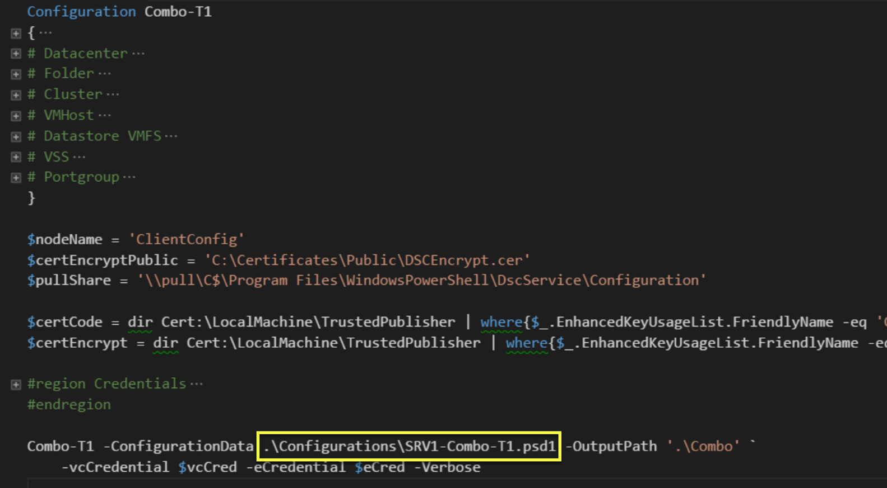

Slide 42
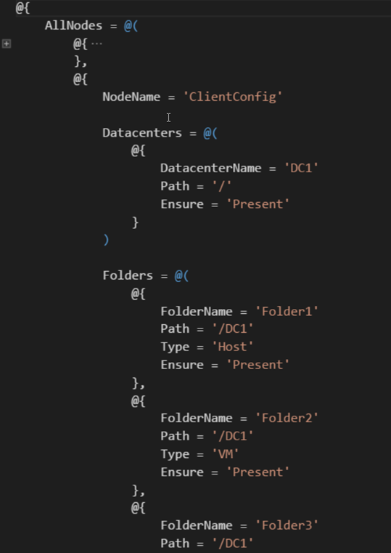

Slide 43
Use Cases
Current environment to SDDC
Version control
Diffs
Replicate the environment
DRM (see also SDDC)
Lab/GreenField
Migration: full or partial migration of environment
New platform
Upgrade

Slide 44
Summary
New release –eq New features
Why pick DSC class-based resources
How to handle a target without a LCM
Legacy systems –ne Logical

Slide 45
Next Steps...
Now: 15 min break
Grab a coffee
Stay here to enjoy next presentation
Change track and switch to another room
Ask me questions or meet me in a breakout session room afterwards

Slide 46
Questions?

Slide 47


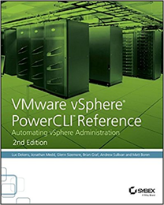
About_Author
Luc Dekens
Belgium (the Flemish part)
Virtualisation ➔ PowerShell/PowerCLI ➔ SDDC ➔ DSC
PowerCLI Reference 1 ed & 2 ed
VMTN Community LucD
Blog LucD.info
Twitter @LucD22

Slide 48
2018
psconf.eu 2018
scheduled to be in the week of
April 16-20, 2018
details on www.psconf.eu as they become available

